Slide 1
Greedy Algorithms
Examination Scheduling Problem
Given
A set of classes
A set of students in each class
Objective: Preparation of shortest examination schedule
Constraints:
There is only one time slot (9:00 -12:00) available for conducting an examination on a day.
Examinations for two classes cannot be scheduled on a day if a student is attending both the classes.

Slide 2
C₁ = {S₁, S₂, S₃, S₄, S₅}
C₂ = {S₂, S₄, S₅, S₆}
C₃ = {S₁, S₂, S₄, S₇, S₈}
C₄ = {S₉, S₁₀, S₂, S₃}
C₅ = {S₁, S₄, S₅, S₉}
C₆ = {S₃, S₄, S₁₀}
C₇ = {S₁, S₁₀}
C₁
C₂
C₇
C₃
C₆
C₄
C₅

Slide 3
Chromatic Number
Given an undirected graph G=(V, E), the chromatic
number of the graph is the minimum number of
colors necessary to color the nodes of the graph
such that no two adjacent nodes have the same
color.
Independent Set
Given an undirected graph G=(V, E), an independent set is a
collection of nodes, such that no two nodes in the subset are
adjacent to each other.
Clique
Given an undirected graph G=(V, E), a clique is a subset of
nodes, such that every pair of nodes are adjacent to each
other.

Slide 4
Greedy Algorithms
Computation of shortest examination schedule is equivalent to computation of the chromatic number of the corresponding graph
How do you compute the chromatic number of a graph?

Slide 5
Strategy to Compute the Chromatic Number
Input: Graph G = (V,E) and a set of colors C={c₁, c₂,…, c_{n}}
Strategy
Color nodes in the order v₁, v₂, …,v_{i}, …,v_{n}
for i=1 to n do
begin
while coloring node v_{i} , use the smallest indexed color, subject to the constraint that it does not violate the adjacency node coloring constraint
end
Question 1: Is this a reasonable approach to solve the problem?
Question 2: Does this strategy work?

Slide 6
v₄
Coloring according to the strategy:
Number of colors used = 3
v₁
v₃
v₂
v₅
v₄
Optimal coloring:
Number of colors used = 2
v₁
v₃
v₂
v₅
The strategy does not work for this example

Slide 7
Greedy Algorithms
A greedy algorithm always makes the choice that looks best at the moment. That is, it makes a locally optimal choice in the hope that this choice will lead to a globally optimal solution.
Unfortunately, in many cases it does not happen.

Slide 8
Activity Selection Problem
Suppose we have a set S = {1, 2, 3, …, n} of n proposed activities that wish to use a resource, such as lecture hall, which can be used by only one activity at a time. Each activity i has a start time s_{i} and a finish time f_{i}, where s_{i} ≤ f_{i} . If selected, activity i takes place during the half-open time interval
[s_{i}, f_{i}). Activities i and j are compatible if the intervals [s_{i}, f_{i}) and [s_{j}, f_{j}) do not overlap (i.e., i and j are compatible if s_{i} ≥f_{j} or s_{j} ≥f_{i} . The activity selection problem is to select a maximum-size of mutually compatible activities.

Slide 9
Activity (Job) Selection Problem
Job# | Start Time | Termination Time
J₁ | 11:00 | 18:00
J₂ | 7:00 | 12:00
J₃ | 17:00 | 22:00
J₄ | 13:00 | 14:00
J₅ | 15:00 | 16:00
J₆ | 6:00 | 8:00
J₇ | 9:00 | 10:00
J₈ | 19:00 | 20:00
J₉ | 21:00 | 23:00
1
2
3
4
5
6
7
8
9
J₁
11
18
J₆
J₇
J₄
J₅
J₈
J₉
6
8
9
10
13
14
15
16
19
20
21
23
J₂
J₃
7
12
17
22

Slide 10
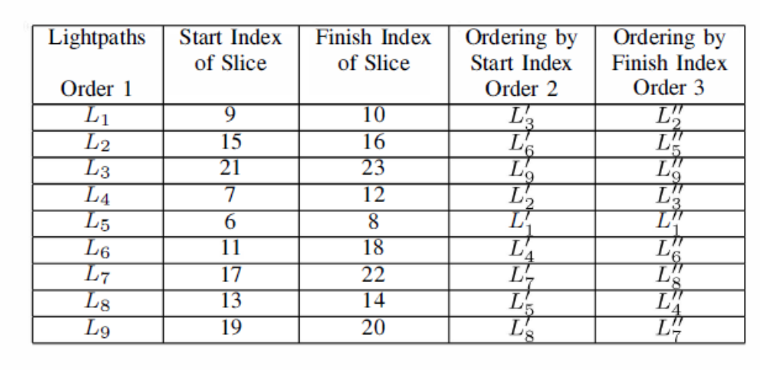
Activity (Job) Selection Problem
6
J₁
11
18
J₆
J₇
J₄
J₅
J₈
J₉
6
8
9
10
13
14
15
16
19
20
21
23
J₂
J₃
7
12
17
22

Slide 11
Activity (Job) Selection Problem
Job# | Start Time | Termination Time |  | Ordering by Start Time | Ordering by Finish Time
J₁ | 11:00 | 18:00 |  | 4 | 6
J₂ | 7:00 | 12:00 |  | 2 | 3
J₃ | 17:00 | 22:00 |  | 7 | 8
J₄ | 13:00 | 14:00 |  | 5 | 4
J₅ | 15:00 | 16:00 |  | 6 | 5
J₆ | 6:00 | 8:00 |  | 1 | 1
J₇ | 9:00 | 10:00 |  | 3 | 2
J₈ | 19:00 | 20:00 |  | 8 | 7
J₉ | 21:00 | 23:00 |  | 9 | 9
J₁
11
18
J₆
J₇
J₄
J₅
J₈
J₉
6
8
9
10
13
14
15
16
19
20
21
23
J₂
J₃
7
12
17
22

Slide 12
Job# | Start Time | Termination Time |  | Ordering by Start Time | Ordering by Finish Time
J₁ | 11:00 | 18:00 |  | 4 | 6
J₂ | 7:00 | 12:00 |  | 2 | 3
J₃ | 17:00 | 22:00 |  | 7 | 8
J₄ | 13:00 | 14:00 |  | 5 | 4
J₅ | 15:00 | 16:00 |  | 6 | 5
J₆ | 6:00 | 8:00 |  | 1 | 1
J₇ | 9:00 | 10:00 |  | 3 | 2
J₈ | 19:00 | 20:00 |  | 8 | 7
J₉ | 21:00 | 23:00 |  | 9 | 9

Slide 13
Activity Selection Problem(s)
Problem 1: Find the maximum number of mutually compatible activities (jobs).
Problem 2: Find the minimum number of auditoriums (processors) needed to process all the activities (jobs).
Problem 3: Suppose that the processing cost of processor P_{i} per job is C_{i,} , 1≤i≤n. If the set of jobs J₁, J₂,…, J_{n}, is distributed among the set of processors P₁, P₂,…, P_{n} such that the number of jobs scheduled on processor P_{i} is x_{i}, 1≤i≤n, x_{i}≥0, then the total processing cost is given by
x₁ C₁ + x₂ C₂ + … + x_{n} C_{n}. How do you distribute the jobs to the processors so that the total processing cost is minimized?

Slide 14
Chromatic Number
Given an undirected graph G=(V, E), the chromatic
number of the graph is the minimum number of
colors necessary to color the nodes of the graph
such that no two adjacent nodes have the same
color.
Independent Set
Given an undirected graph G=(V, E), an independent set is a
collection of nodes, such that no two nodes in the subset are
adjacent to each other.
Clique
Given an undirected graph G=(V, E), a clique is a subset of
nodes, such that every pair of nodes are adjacent to each
other.

Slide 15
Activity Selection Problem(s)
Problem 1 can be solved by finding the maximum independent set of the graph formed by the start and the finish times of the activities (jobs).
Problem 2 can be solved by finding the chromatic number of the graph formed by the start and the finish times of the activities (jobs).
Problem 3 cannot be solved by computing the chromatic number, maximum independent set or any other known problem. Requires novel strategies for the solution of the problem.

Slide 16
Strategies for solution of Problem 2
Strategy 1: Compute a largest independent set of the graph formed by the start and the finish times of the jobs. Put this set of jobs in one processor and remove the corresponding nodes from the graph. Compute a largest independent set of the remaining graph, put this set of jobs in the second processor and remove the corresponding nodes from the graph. Continue the process till all jobs are assigned to some processor.
Does the strategy work?
Answer: No

Slide 17
Strategies for solution of Problem 3
Strategy 1: Compute a largest independent set of the graph formed by the start and the finish times of the jobs. Put this set of jobs in the least expensive processor and remove the corresponding nodes from the graph. Compute a largest independent set of the remaining graph, put this set of jobs in the second least expensive processor and remove the corresponding nodes from the graph. Continue the process till all jobs are assigned to some processor.
Strategy 2: Partition the node set of the graph formed by the start and the finish times of the activities (jobs) into the fewest number of independent sets. This is equivalent to finding the chromatic partition of the graph formed by the start and the finish times of the activities (jobs).
Does any one of the strategies work?

Slide 18
Activity (Job) Selection Problem
Strategy 1 Solution: {4, 5, 6, 7, 8, 9} in Processor 1
{2, 3} in Processor 2
{1} in Processor 3
Solution Cost: 6C₁ + 2C₂ + C₃
Strategy 2 Solution: {1, 6, 7, 8, 9} in Processor 1
{2, 3, 4, 5} in Processor 2
Solution Cost: 5C₁ + 4C₂
Conclusion: None of the strategies may find the optimal solution
1
2
3
4
5
6
7
8
9
J₁
11
18
J₆
J₇
J₄
J₅
J₈
J₉
6
8
9
10
13
14
15
16
19
20
21
23
J₂
J₃
7
12
17
22

Slide 19
Activity Selection Problem
Suppose we have a set S = {a₁, a₂, a₃, …, a_{n}} of n proposed activities that wish to use a resource, such as lecture hall, which can be used by only one activity at a time. Each activity i has a start time s_{i} and a finish time f_{i}, where s_{i} ≤ f_{i} . If selected, activity i takes place during the half-open time interval
[s_{i}, f_{i}). Activities i and j are compatible if the intervals [s_{i}, f_{i}) and [s_{j}, f_{j}) do not overlap (i.e., i and j are compatible if s_{i} ≥f_{j} or s_{j} ≥f_{i} . The activity selection problem is to select a maximum-size of mutually compatible activities.

Slide 20
Activity Selection Problem (ASP)
Algorithm for ASP
Assume that the activities are ordered by monotonically increasing finish time
f₁ ≤ f₂ ≤ … ≤ f_{n} .
If not, we can sort them into this order in time O(n lg n), breaking ties
arbitrarily. The pseudocode assumes that inputs s and f are represented as arrays.
GREEDY-ACTIVITY SELECTOR (s, f)
n ← length[s]
A ← {a₁}
i ← 1
for m ← 2 to n do
if s_{m} ≥ f_{i}
then A ← A U {a_{m}}
i ← m
return A

Slide 21
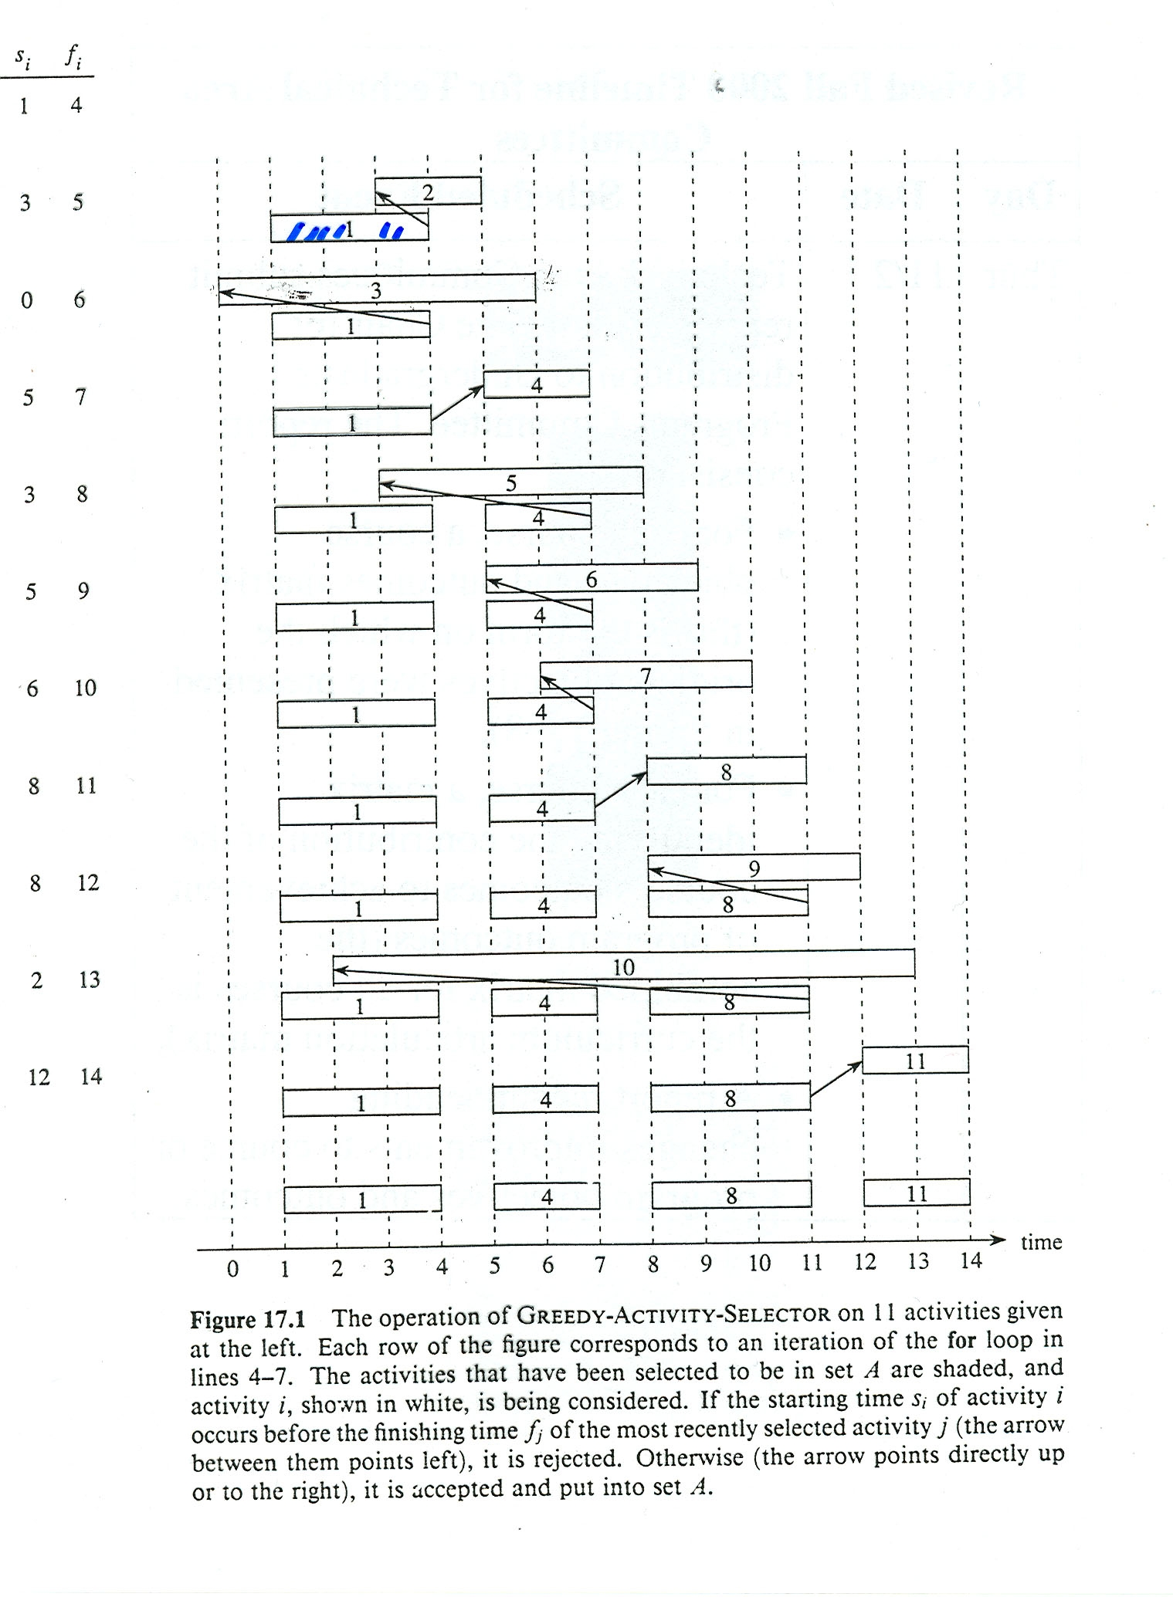

Slide 22
Algorithm for ASP
Does it work?
  Yes
  Why?
Observation 1: Optimal solution is not necessarily unique
Claim 1: At least one optimal solution contains the activity a₁
  How do we know that?
  Suppose {a₅, a₇, a₈, a₁₂, a₁₅} is an optimal solution. Consider the following activity set {a₁, a₇, a₈, a₁₂, a₁₅}. Is this set an optimal solution?
  Yes
    Why?
    Since a₅ and a₇ are part of an optimal solution, the start time of a₇ must be after the finish time of a_{5.} Since the finish time of a₁ is earlier than that of the finish time of a₅, there will be no conflict between a₁ and a_{7.} Therefore, the activity set {a₁, a₇, a₈, a₁₂, a₁₅} will also be an optimal solution.

Slide 23
Algorithm for ASP
Claim 2
  Once a₁ is chosen, the problem of finding the optimal solution for the set S = {a₁, a₂, a₃, …, a_{n}} reduces to the problem of finding an optimal solution for the ASP over those activities in S that are compatible with activity a₁.
  In other words, if A is an optimal solution for the original problem S, then A’ = A – {a₁} is an optimal solution to the ASP, S’ = {a_{i} in S: s_{i} ≥ f₁}
  Why?
  If another activity set B’ with more activities than A’ was the optimal solution of S’, then adding a₁ to B’, will produce a solution for S with more activities than A, thereby contradicting the optimality of A.

Slide 24
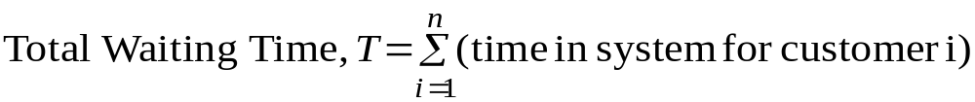
Minimizing Time in the System
A single server (e.g., a checkout counter in a store) has n customers to serve.
The service time required by each customer is known in advance: customer i will
take time t_{i} , 1≤i≤n. The customers should be served in a way that minimizes the average waiting time of customers.
Average waiting time of customers will be minimized if the total time spent by the customers in the system is minimized.
Let I = (i₁ i₂ … i_{n}) be any permutation of the integers {1, 2, …, n}. If the customers are served in the order I, the total time passed in the system by all customers is
T(I) = t_{i1} + (t_{i1}+ t_{i2}) + (t_{i1}+ t_{i2}+ t_{i3}) + … + (t_{i1}+ … + t_{in})
= nt_{i1} + (n-1)t_{i2} + (n-2)t_{i3} + … + t_{in}
= Σ_{k=1 to n} (n–k+1)t_{ik}

Slide 25
Minimizing Time in the System
Suppose now that, I is such that we can find two integers a and b with a<b and t_{ia} > t_{ib}
New service order I’ is obtained from I by interchanging the service orders of a and b.
T(I’) = (n-a+1)t_{ib}+ (n-b+1)t_{ib}+ Σ_{k=1 to n, k≠a,b}(n-k+1)t_{ik}

Slide 26
service order 1 2 … a … b … n
served customer i₁ i₂ i_{a} i_{b} i_{n}
(from I)
service duration
After exchange
of i_{a} and i_{b}
service duration
served customer i₁ i₂ i_{b} i_{a} i_{n}
(from I’)
t_{i1}
t_{i2}
…
t_{ia}
…
t_{ib}
…
t_{in}
t_{i1}
t_{i2}
…
t_{ib}
…
t_{ia}
…
t_{in}

Slide 27
Thus,
T(I) – T(I’) = (n-a+1)(t_{ia}- t_{ib}) + (n-b+1)(t_{ib}-t_{ia})
= (b-a)(t_{ia}- t_{ib})
> 0
We can therefore improve any schedule in which a customer is served before someone else who requires less service. The only schedules that remain are those putting the customers in non-decreasing order of service time. All such schedules are clearly equivalent, and therefore they are all optimal.

Slide 28
Job Scheduling Problem
Input:
J₁ J₂ … J_{n} ← set of jobs
t₁ t₂ … t_{n} ← execution time
d₁ d₂ … d_{n} ← deadline
p₁ p₂ … p_{n} ← Profit
Objective: Maximize profit subject to the deadline constraint
A set of jobs is feasible if there exists at least one sequence (also called a feasible sequence) that allows all the jobs in the set to be executed in time for their respective deadlines.
Strategy: Construct the schedule step by step, adding at each step the job with the highest value of P_{i}

Slide 29
Job Scheduling Problem
We consider two special cases of the Job Scheduling Problem
Problem 1:
J₁ J₂ … J_{n} ← set of jobs
t₁ t₂ … t_{n} ← execution time
d₁ d₂ … d_{n} ← deadline
Question: Is there a feasible schedule (i.e., a schedule where all the jobs finish before their deadlines)?
Problem 2:
J₁ J₂ … J_{n} ← set of jobs
t₁ = t₂ … = t_{n} ← execution time
d₁ d₂ … d_{n} ← deadline
P₁ P₂ … P_{n} ← Profit
Find the schedule that maximizes the profit.

Slide 30
Problem 1: Given a set of jobs, their execution times and
their deadlines, is there a feasible schedule?
Consider a schedule where the jobs are executed in the order of increasing deadlines and call it Increasing Deadline Sequence (IDS).
Claim: A set of jobs J is feasible if and only if an IDS (Increasing Deadline Sequence) of J is feasible.
If IDS is feasible then we are done.
Claim: If IDS is not feasible, no other schedule (ordering of the jobs) can be feasible.
Equivalent Claim: If there exists any feasible schedule, then the IDS must be feasible.

Slide 31
Suppose that there exists a feasible schedule
J₁, J₂, … , J_{k-1}, J_{k}, J_{k+1}, …, J_{n} that is non-IDS (NIDS)
Suppose that J_{k} and J_{k+1} are the first two jobs in this NIDS where the increasing deadline condition is violated, i.e.,
J₁, J₂, … , J_{k-1}, J_{k}, J_{k+1}, …, J_{n} where,
d₁ ≤ d₂ ≤ … ≤ d_{k-1} ≤ d_{k} > d_{k+1}
(there may be other violations later on)

Slide 32
Since J₁, J₂, … , J_{k-1}, J_{k}, J_{k+1}, …, J_{n} is feasible, we have
t₁ ≤ d₁ …(1)
t₁ + t₂ ≤ d₂ …(2)
.
.
.
t₁ + t₂ + … + t_{k-1} ≤ d_{k-1} …(k-1)
t₁ + t₂ + … + t_{k-1} + t_{k} ≤ d_{k} … (k)
t₁ + t₂ + … + t_{k-1} + t_{k} + t_{k+1} ≤ d_{k+1} … (k+1)
t₁ + t₂ + … + t_{k-1} + t_{k} + t_{k+1} + t_{k+2} ≤ d_{k+2} …(k+2)
.
.
.
t₁ + t₂ + … + t_{n} ≤ d_{n} …(n)

Slide 33
Job Scheduling Problem
The NIDS J₁, J₂, … , J_{k-1}, J_{k}, J_{k+1}, …, J_{n} is feasible
J_{k} and J_{k+1} are the first two jobs in this NIDS where the increasing deadline condition is violated, i.e.,
J₁, J₂, … , J_{k-1}, J_{k}, J_{k+1}, …, J_{n} where,
d₁ ≤ d₂ ≤ … ≤ d_{k-1} ≤ d_{k} > d_{k+1}
(there may be other violations later on)
Change the order of J_{k} and J_{k+1}, keeping everything else intact. Call this new sequence to be NIDS’.

Slide 34
Only inequalities (k) and (k+1) among the set of feasibility testing inequalities, will be affected by this switch.
We need to check if the inequalities continue to be satisfied after the switch.
k-th and (k+1)-th inequalities in NIDS’
  t₁ + t₂ + … + t_{k-1} + t_{k+1} ≤ d_{k+1} (?) ………..(A)
  t₁ + t₂ + … + t_{k-1} + t_{k+1} + t_{k} ≤ d_{k} (?)………(B)
k-th and (k+1)-th inequalities in NIDS are true
  t₁ + t₂ + … + t_{k-1} + t_{k} ≤ d_{k} …………………..(C)
  t₁ + t₂ + … + t_{k-1} + t_{k} + t_{k+1} ≤ d_{k+1}…………(D)
It is also known that d_{k} > d_{k+1} …………………….(E)
Since t₁ + t₂ + … + t_{k-1} + t_{k} + t_{k+1} ≤ d_{k+1} (D), then t₁ + t₂ + … + t_{k-1} + t_{k+1} ≤ d_{k+1} (A)
Since t₁ + t₂ + … + t_{k-1} + t_{k} + t_{k+1} ≤ d_{k+1} (D), and d_{k} > d_{k+1} (E) then
t₁ + t₂ + … + t_{k-1} + t_{k+1} + t_{k} ≤ d_{k} (B)
If NIDS is feasible, so is NIDS’.
NIDS’ has one less violation w.r.t. IDS in comparison with NIDS.
By repeating the process any feasible sequence can be converted to an IDS sequence.

Slide 35
Job Scheduling Problem
Problem 2:
J₁ J₂ … J_{n} ← set of jobs
t₁ = t₂ … = t_{n} ← execution time
d₁ d₂ … d_{n} ← deadline
p₁ p₂ … p_{n} ← Profit
Find the schedule that maximizes the profit.
Example:
  J_{i} 1 2 3 4
  d_{i} 2 1 2 1
  p_{i} 50 10 15 30

Slide 36
Job Scheduling (Problem 2)
Strategy: At every stage of selection, pick up the job with the maximum profit, subject to the constraint that a feasible schedule with this job, along with the jobs selected so far, can be constructed.
Example:
  J_{i} 1 2 3 4
  d_{i} 2 1 2 1
  p_{i} 50 10 15 30
Select job 1 and put it in the solution set S.
Select job 4. Check if a feasible schedule with {1, 4} can be constructed. The answer is yes. Add 4 to S.
Select job 3. Check if a feasible schedule with {1, 4, 3} can be constructed. The answer is no. Do not add 3 to S.
Select job 2. Check if a feasible schedule with {1, 4, 2} can be constructed. The answer is no. Do not add 2 to S.
Final solution set S contains jobs 1 and 4.

Slide 37
Job Scheduling (Problem 2)
Does the strategy work?
  Answer: Yes
  Why?
Proof of Optimality
  I: Set of jobs selected by the Greedy algorithm
  J: Set of jobs selected by the Optimal algorithm
  S_{J} ➔ feasible sequence for the set J
  S_{I} ➔ feasible sequence for the set I
By making appropriate interchanges of the jobs in S_{I} and S_{J} , obtain two feasible sequences S_{I}’ and S_{J}’, such that every job common to both I and J is scheduled for execution at the same time in the two sequences (there may be gaps in the schedule).

Slide 38
Job Scheduling Problem
By making appropriate interchanges of the jobs in S_{I} and S_{J} , obtain two feasible sequences S_{I}’ and S_{J}’, such that every job common to both I and J is scheduled for execution at the same time in the two sequences (there may be gaps in the schedule).
p
y
q
x
r
S_{I}
r
s
t
p
u
v
q
w
S_{J}
after reorganization
x
y
p
r
q
S_{I}’
u
s
t
p
r
v
q
w
S_{J}’

Slide 39
Job Scheduling Problem
If some task ‘a’ is scheduled in S_{I}’ whereas there is a gap in S_{I}’ (and therefore task a does not belong to J), the set J U {a} is feasible and would be more profitable than J. This not possible since J is optimal by assumption.
If some task ‘b’ is scheduled in S_{J}’ whereas there is a gap in S_{I}’ , the set I U {b} is feasible, hence the greedy algorithm should have included b in I. This is also impossible since it did not do so.

Slide 40
Job Scheduling Problem
The only remaining possibility is that some task ‘a’ is schedule in S_{I}’ whereas a different task ‘b’ is scheduled in S_{J}’. Again, this implies that ‘a’ does not appear in J and that ‘b’ does not appear in I.
  If p_{a} > p_{b}, one could substitute ‘a’ for ‘b’ in J and improve it. This goes against the optimality of J
  If p_{a} < p_{b}, the greedy algorithm should have chosen ‘b’ before even considering ‘a’ since (I - {a}) U {b} would be feasible. This is not possible either since it did not include ‘b’ in I.
  The only remaining possibility is therefore that p_{a} = p_{b}.
Conclusion
  Total Profit of the set of jobs I is equal to the total profit of the set J.
  The Greedy Scheduling Algorithm produces Optimal Solution

Slide 41
Communication Network Design Problem
Given a set of cities C={C₁, C₂,…, C_{n}}, and the cost of establishing a communication link between every pair of cities, design the least-cost communication network, so that message communication can take place between any pair of cities.

Slide 42
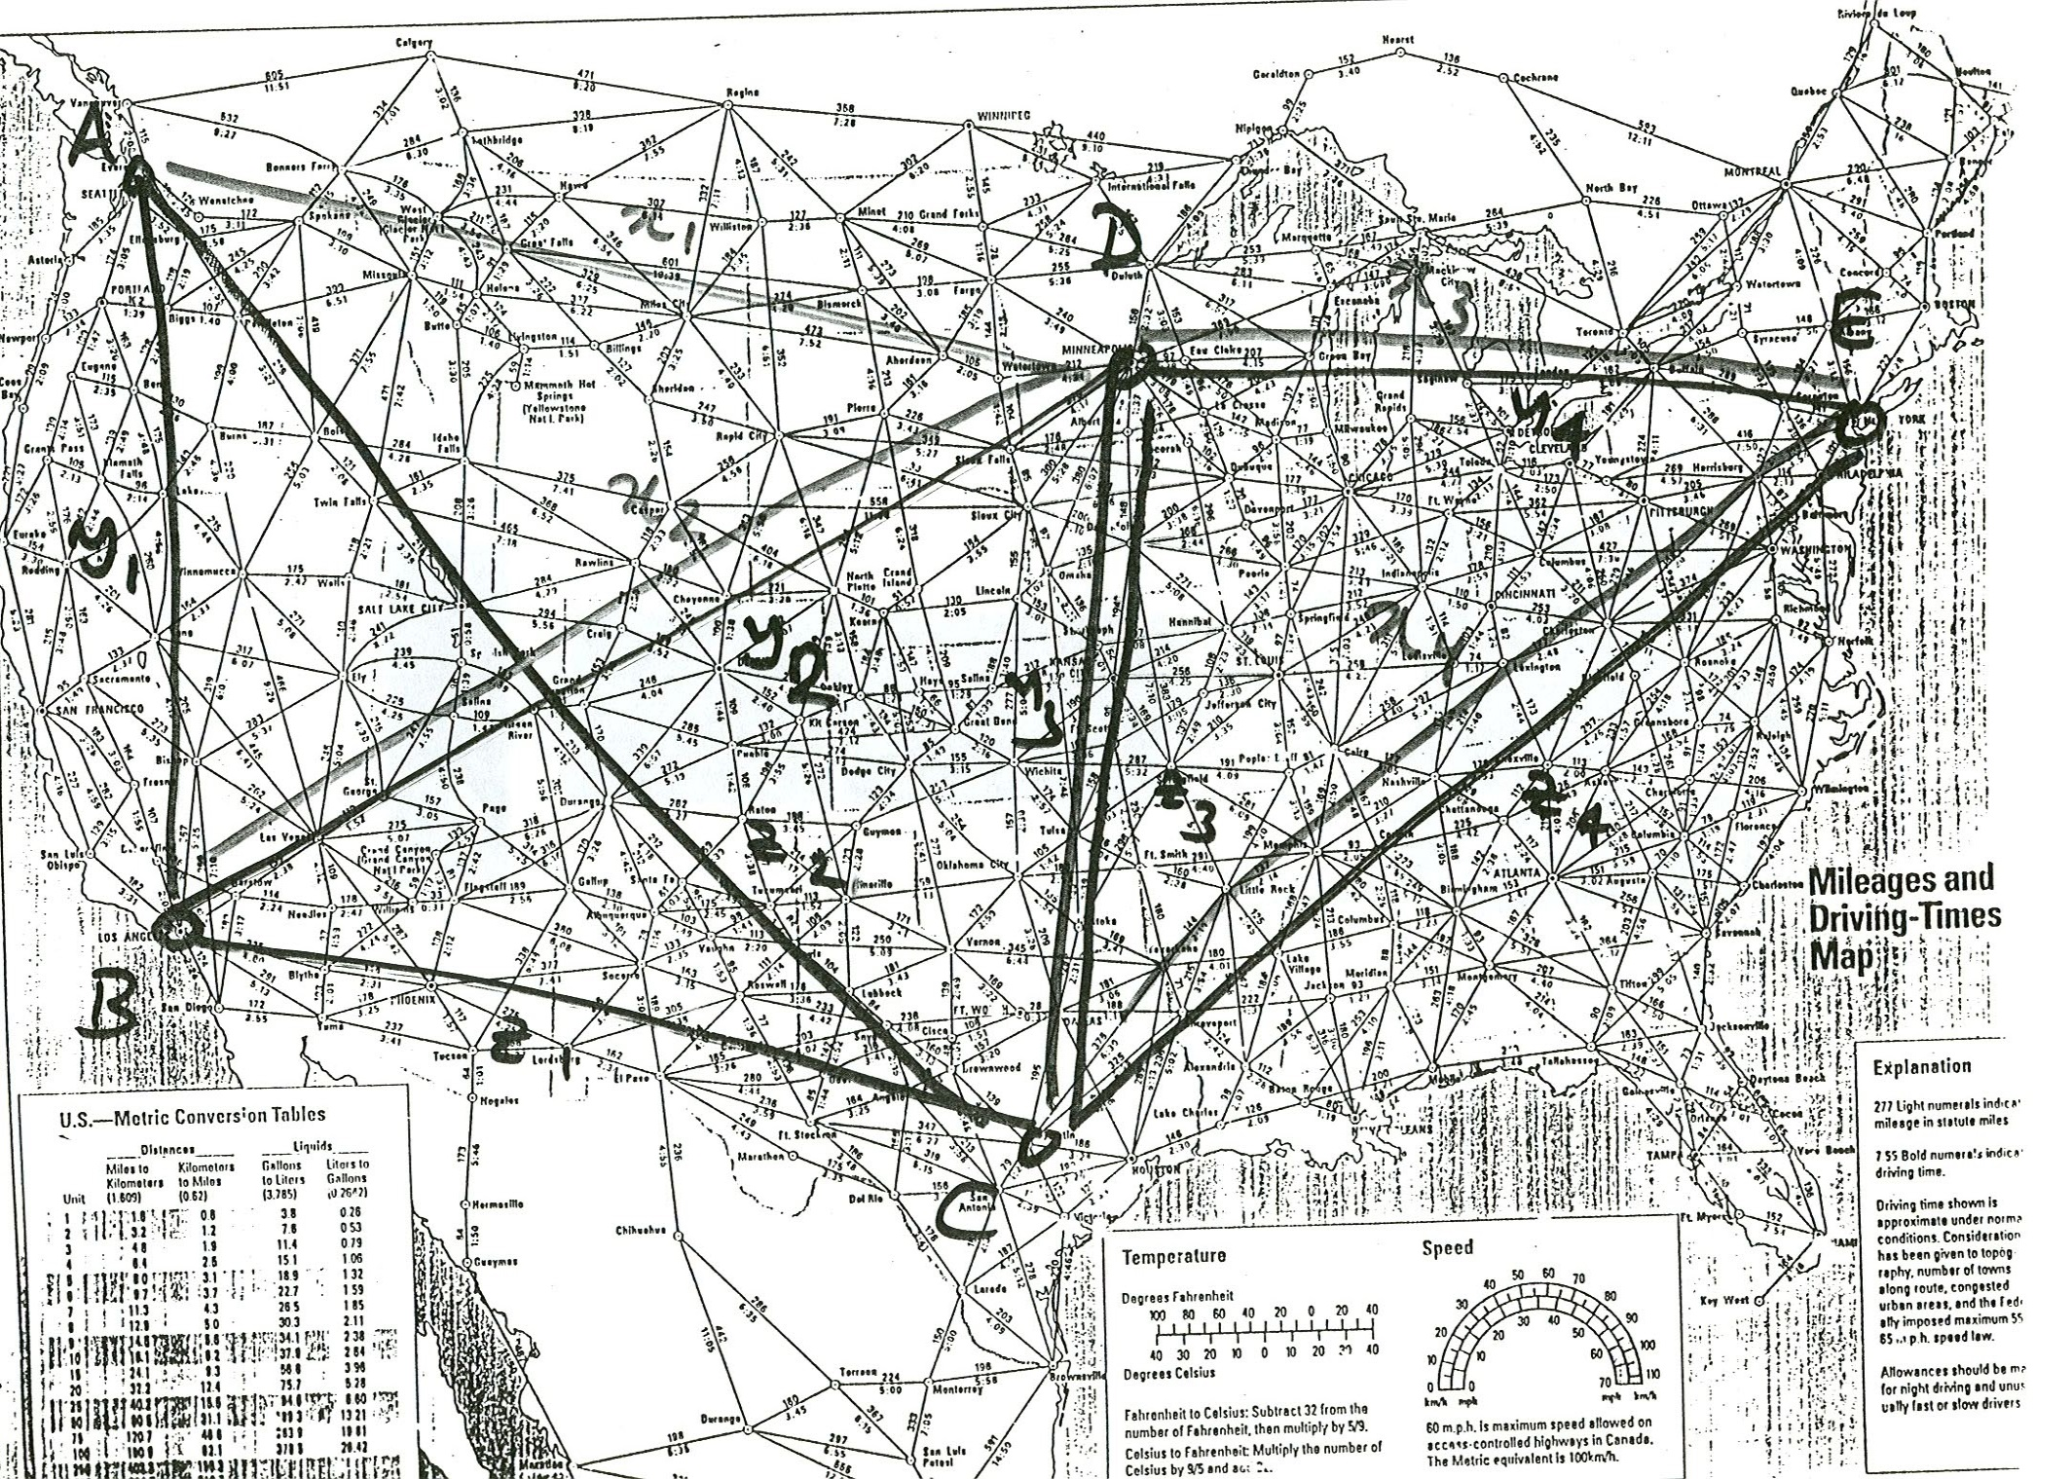

Slide 43
Spanning Tree
  Spanning tree of a graph is a tree that spans over all the nodes of the graph
  A spanning tree of minimum weight is called a minimum spanning tree.
Number of Spanning Trees
  How many different spanning trees are there for a complete graph with n nodes?
  Answer: n^{n-2}

Slide 44
1
4
1
4
1
4
1
4
2
3
2
3
2
3
2
3
1
4
1
4
1
4
1
4
2
3
2
3
2
3
2
3
1
4
1
4
1
4
1
4
2
3
2
3
2
3
2
3
1
4
1
4
1
4
1
4
2
3
2
3
2
3
2
3
For, 4 nodes: total number of possible spanning trees = 16
In general, for n nodes: number of possible spanning trees = n^{n-2}

Slide 45
Minimum Spanning Tree (Kruskal’s Algorithm)
Input: Graph G = (V, E) and the link cost on the edges E
begin
T = Ø
while (T contains less than (n-1) edges and E is not empty do)
begin
choose an edge (v, w) from E of lowest cost
delete (v, w) from E.
if (v, w) does not create a cycle in T then
add (v, w) to T
else
discard (v, w)
end
end

Slide 46
Edges ordered by weight:
(a,f), (c,d), (b,g), (b,c),(d,g), (d,e), (e,g), (e,f), (a,b), (f,g)
Edges selected in the spanning
tree T*:
e₁ = (a, f)
e₂ = (c, d)
e₃ = (b, g)
e₄ = (b, c)
e₅ = (d, e)
e₆ = (e, f)
10
a
28
f
b
30
14
25
g
16
24
e
18
c
22
d
12
10
a
28
f
b
30
14
25
g
16
24
e
18
c
22
d
12
T*

Slide 47
Minimum Spanning Tree
Theorem: Any spanning tree T* = {e₁, e₂, …, e_{n-1}}
constructed by Kruskal’s algorithm is an optimal tree.
Suppose that T is a spanning tree
f(T): The smallest value of i such that e_{i} is not in T
T*: Spanning tree constructed by Kruskal’s algorithm.
Proof (by contradiction): Assume that T* is not an optimal tree and let T be an optimal tree such that f(T) is as large as possible.

Slide 48
T₁ = {(a, f), (b, g), (b, c),
(g, e), (g, d), (a, b)}
T₂ = {(a, f), (f, e), (g, e),
(g, d), (c, d), (b, c)}
T* = {(a, f), (c, d), (b, g),
(b, c), (d, e), (e, f)}
f(T₁) = 2
f(T₂) = 3
10
a
28
f
b
30
14
25
T₁
g
16
24
e
18
c
22
d
12
10
a
28
f
b
30
14
T₂
25
g
16
24
e
18
c
22
d
12

Slide 49
Suppose, f(T) = k;
{e₁, e₂, …, e_{k-1}} are in both T and T*, but e_{k} is not in T
T+e_{k} obtains a unique cycle
e_{k}’ ➔ an edge of C that is in T but not in T*
T’= (T + e_{k}) – e_{k}’
T’ is connected graph with (n-1) edges.
T’ is another spanning tree
w(T ’) = w(T) + w(e_{k}) – w(e_{k}’)

Slide 50
Since {e₁, e₂, …, e_{k-1}, e_{k}} is a subgraph of T, it is acyclic
w(e_{k}’) ≥ w(e_{k})
w(T ’) ≤ w(T)
T ’ is also an optimal spanning tree.
f(T ’) = k+1 > f(T), which leads to a contradiction.

Slide 51
Matching
  Given an undirected graph G=(V, E), a matching is a subset of edges such that no two edges in the subset have a common endpoint.
Independent Set
  Given an undirected graph G=(V, E), an independent set is a collection of nodes, such that no two nodes in the subset are adjacent to each other.
Clique
  Given an undirected graph G=(V, E), a clique is a subset of nodes, such that every pair of nodes are adjacent to each other.

Slide 52
Dominating Set
  Given an undirected graph G = (V, E), a dominating set is a subset of nodes, such that every other node of the graph is adjacent to at least one node in this subset.
Node Cover
  A subset of nodes, such that every edge of the graph has at least one end point in this set.

Slide 53
Bipartite Graph
  A graph whose node set can be partitioned into two groups such that the edges connect the nodes of different groups only.
A
B

